Slide 1


Airbnb vs Hotels: Where will you stay?
Huma Ghiya, Omar Farag, Mary phillipuk, halak patel

Slide 2


Core Message / Hypothesis
Based on price and ratings, which is a more favorable option for lodging: Airbnb vs Hotel?

Slide 3

8 Destinations
New York | Beijing
Las Vegas | Paris
Los Angeles | Madrid
Sydney | Amsterdam

Slide 4
Core Message / Hypothesis Cont.
QUESTIONS FOR RESEARCH:
Does Location effect the price and ratings of Hotels vs Airbnb?
How do lodging fees differ city to city and neighborhood to neighborhood in the same city?
Which has a greater # of lodging listings in a single city: Airbnb vs Hotel
How do prices effect ratings in a single city?
FACTORS TO BE CONSIDERED:
Price
Ratings
Location: 8 major cities throughout the United State & Internationally
Density

Slide 5
Core Questions: Why they are important?
In order to answer the bigger question– “Based on price and ratings, which is a more favorable option for lodging: Airbnb vs Hotel?”– we need to ask additional questions.
Recap of research questions:
Locations effect on price and ratings of Hotels vs Airbnb?
Compare lodging fees differ city to city and neighborhood to neighborhood in the same city?
Greater # of lodging listings in a single city: Airbnb vs Hotel
In order to determine which is overall a better lodging choice: Airbnb vs Hotel, we must look at data to compare and contrast important factors an individual may consider before making a choice:
Location- We chose 8 major cities (US and Internationally) to compare how location effects prices and ratings
Price- We observed fees for both Hotels and Airbnb in different locations to research which location has the highest and lowest fees for lodging
Ratings – We observed how ratings differ for Hotels and Airbnbs and how ratings also differ for both in different cities and different neighborhoods within cities
Prices correlation with ratings

Slide 6

Questions and Data
Question | Data Needed | Data Source
Does Location effect the price and ratings of Hotels Vs. Airbnb | Airbnb data for pricing and ratings in 8 cities Density in 8 cities Hotel data for pricing and ratings in 8 cities Density 8 cities | Airbnb Data: http://insideairbnb.com/get-the-data.html Hotel Data: https://github.com/lucasmonteiro001/free-world-hotel-database/blob/master/hotels.csv.zip Tripadvisor
How do lodging fees differ city to city and neighborhood to neighborhood in the same city? | Airbnb data for pricing and ratings in 8 cities Density in 8 cities Hotel data for pricing and ratings in 8 cities Density in 8 cities | Airbnb Data: http://insideairbnb.com/get-the-data.html Hotel Data: https://github.com/lucasmonteiro001/free-world-hotel-database/blob/master/hotels.csv.zip
Which has a greater # of lodging listings in a single city: Hotel Vs. Airbnb? | Heat maps generated from Hotel and Airbnb data | Airbnb Data: http://insideairbnb.com/get-the-data.html Hotel Data: https://github.com/lucasmonteiro001/free-world-hotel-database/blob/master/hotels.csv.zip
How do prices effect ratings in a single city? | Airbnb data for pricing and ratings in 8 cities Hotel data for pricing and ratings in 8 cities | Airbnb Data: http://insideairbnb.com/get-the-data.html Hotel Data: https://github.com/lucasmonteiro001/free-world-hotel-database/blob/master/hotels.csv.zip

Slide 7

Data Clean-Up and Exploration
Data Cleaning:
In order to clean our research data, we utilized Jupyter Notebook.
We cleaned up the city data as follow:
Reformatted via Jupyter Notebook
We identified some cities were more dense than others –prices varied (10 K for some Airbnbs)
Some columns contained strings and needed to be converted
Some cities were not labeled—therefore, we used google API to box each city
What we anticipated: Heat maps– We anticipated some of the Airbnbs may be labeled as NY but may actually be located outside of the city
Problems we ran into:
Finding comparable data for hotels
We were only able to access Hotel data for 2016
Our Hotel data was on a smaller scale than our Airbnb data
Presentation and discussion of interesting figures developed during exploration:

Slide 8
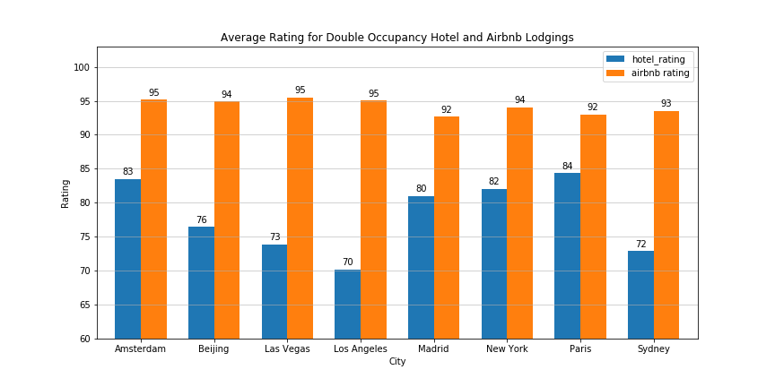
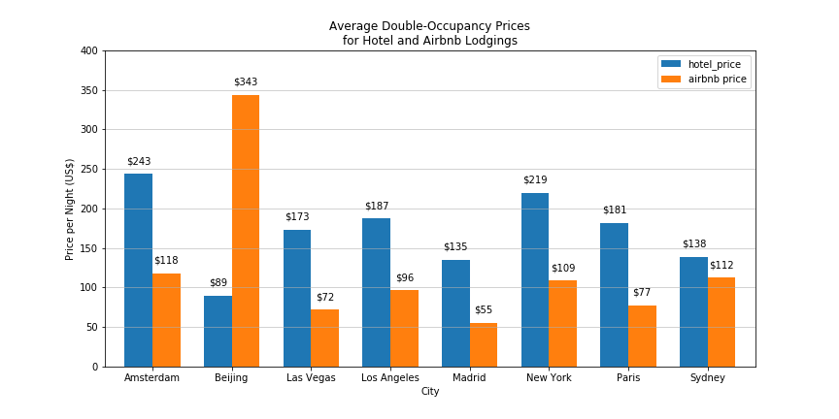
Data Analysis: Airbnb Vs. Hotel

Slide 9
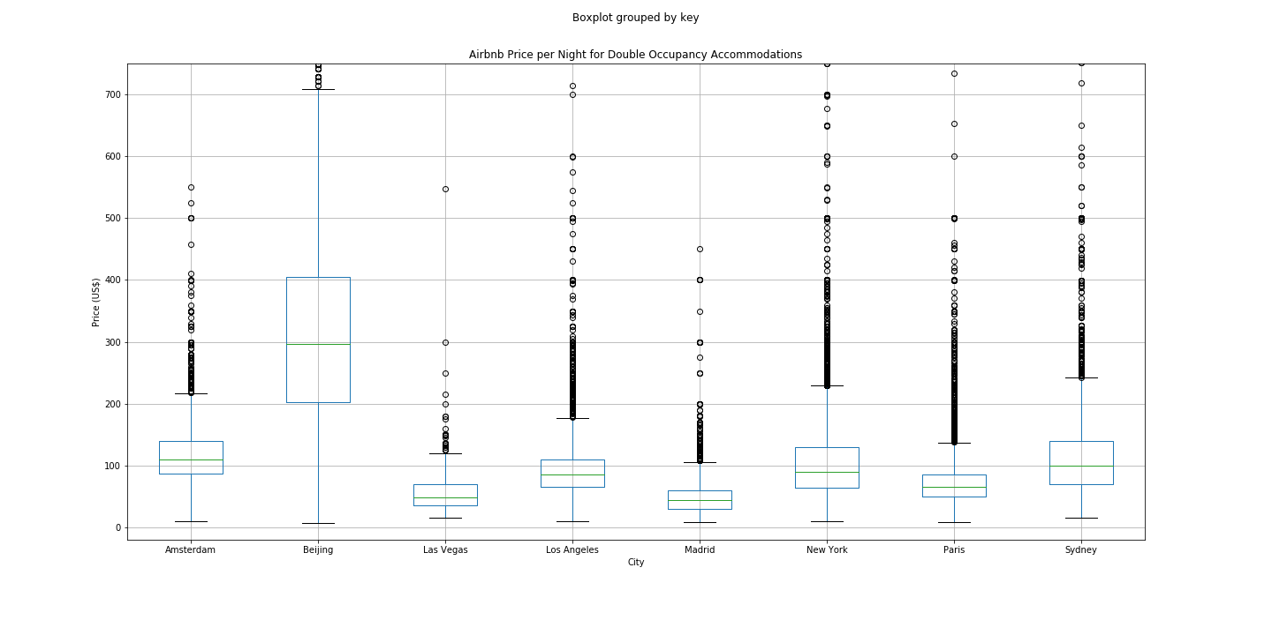
Airbnb: Price Analysis

Slide 10
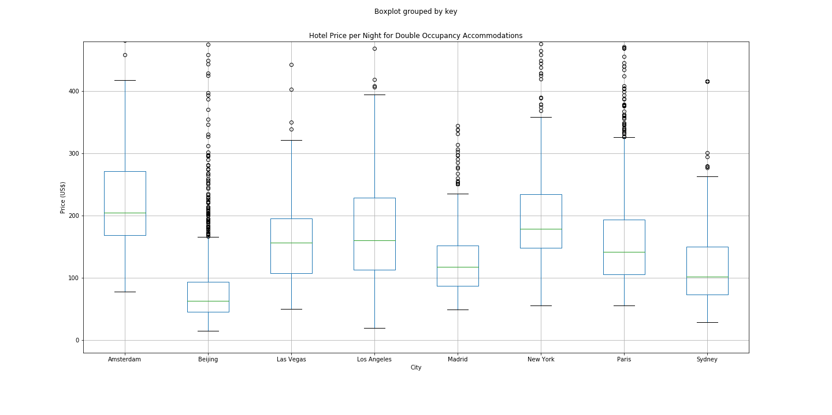
Hotel: Price Analysis

Slide 11
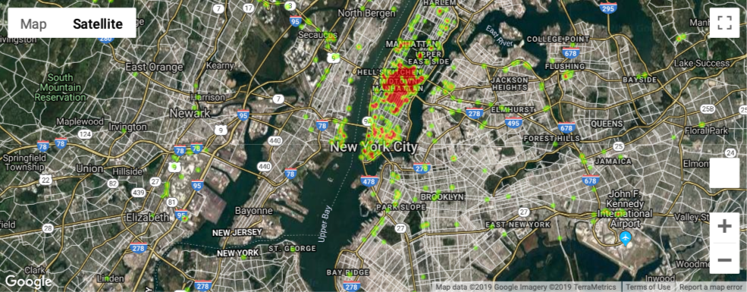
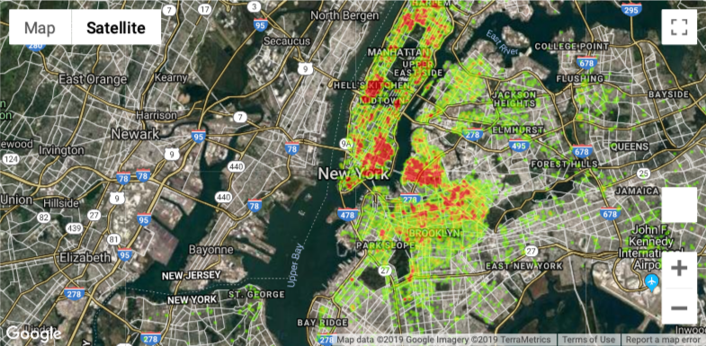
New York Heat Maps
Hotel
Airbnb

Slide 12
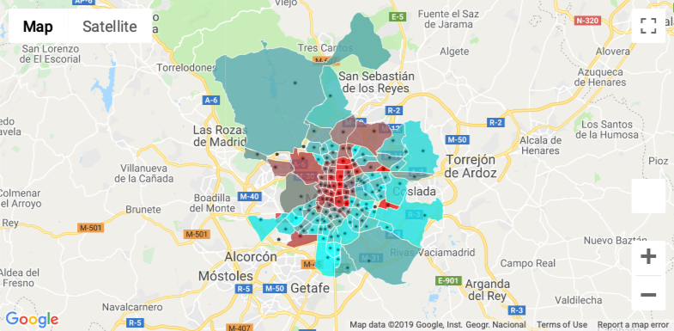
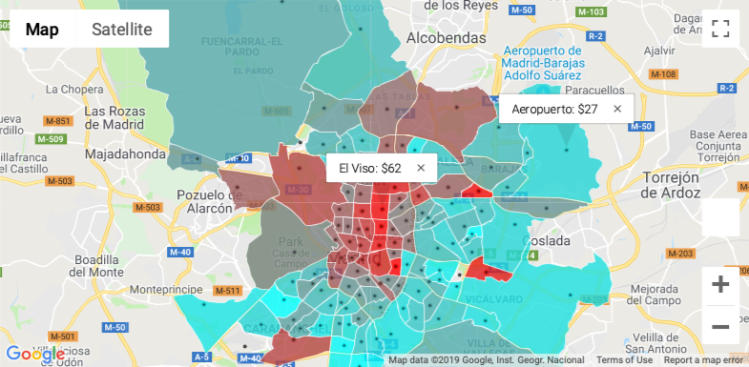
Madrid Chloropleth

Slide 13
Discussion
Discussion of our findings:
Due to popularity, high-demands, and prices we were expecting to find that Airbnbs would be a more favorable option of lodging as compared to hotels.
Upon our research and data analysis, we came to the conclusion that Airbnb indeed is a more favorable lodging option based upon prices and ratings.
Airbnb has lower prices and higher ratings in comparison to Hotels in all 8 cities as per our research.

Slide 14
Post Mortem
Difficulties that arose and how we dealt with them:
We were unable to uncover significant amount of Hotel Data
In order to access Hotel API, we needed to be a business partner
Additional questions / thoughts:
If we had more time, we would analyze additional data that may effect which of the two lodging options is the optimal choice by looking at factor such as: Amenities, Extra services offered, Group size, and transportation
If we had two more weeks, we would analyze data for the distance between Hotels, Airbnbs and attractions in each city
Conduct a qualitative assessment of other factors such as community, housing data, number of jobs, Airbnbs effect of hospitality industry

Slide 15

Q&A

